Slide 1
The Role of Inner Wheel in Europe
within the Global Community of
International Inner Wheel Countries
National Representative IW Germany Jutta Stender-Vorwachs, September 10, 2019
,

Slide 2
In Europe we have similar values in Inner Wheel
Independence
of men / husbands / partners
of Rotary
of conventions by the society
We in Europe are independet women who decide by themselves.

Slide 3
Ideals and Ethics
We are proud of our membership.
We are enthusiastic.
We are pragmatic in social and cultural projects.
We are part of an association of different cultures and languages.
That means
Yes we can:
Achieve a better recognition in society
Initiate more transparency in our communication

Slide 4
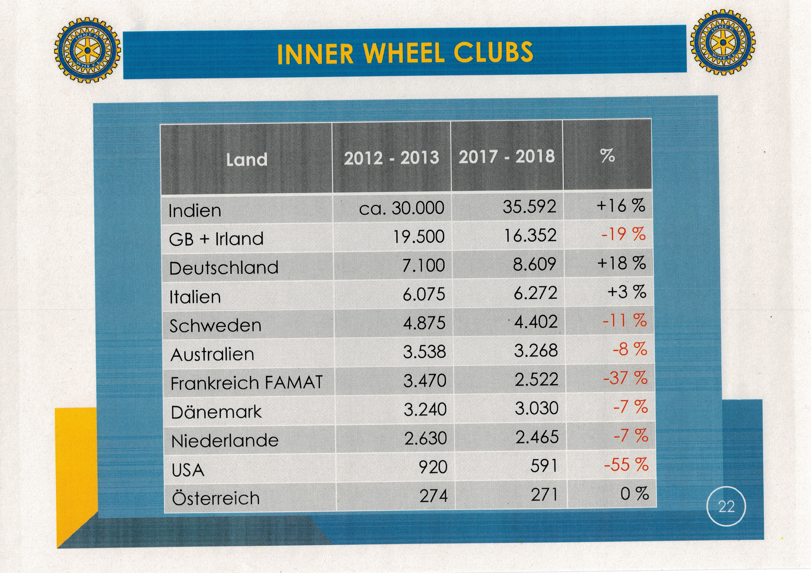

Slide 5
Inner Wheel in India and Consequences
First Club in India: 1955
Four Districts: 1966
National Council: 1968
27 Distrikte actually
President and National Representative Mampta Gupta: „It is about time that we make our INNER WHEEL identity more transparent and trustful in society.” “Please put a big Inner Wheel logo in all the projects and write ‘World’s Largest Women’s Voluntary Service Organization’ that shows the unity and “Together we can” contribute in branding Inner Wheel, which should be our Mantra.”
Consequence: We have the same Mantra. We should not work against but with each other.
But we have to stay together in Europe.

Slide 6
Consequences:
Let us in International Inner Wheel act together in friendship,
Keep the European values, but accept other cultures.
Always be aware of the integrity of officers.
Support transparency in Europe (Newletters to be exchanged).
Let us design Inner Wheel in Europe with values, responsibility, social engagement and networking.

Slide 7
Many Thanks
for your Interest
National Representative IW Germany Jutta Stender-Vorwachs, September 10, 2019

