Slide 3
3 WORKSHOPS
FAMILY(Coordinator:Hannele Karhunen ,IIWpBD ,Finland)
1. Domestic violence. Children as victims or witnesses of abuse.
2. Children and families in adverse life situations
3. Children with special educational needs
JOB(Coordinator:Hildegund Scheipermeier,IIW pBD,Germany)
1. Child labor. Breaking into the…fairytale.
2. Child trafficking and child pornography.
3. Child labor conditions. Impact on mental and physical health.
CULTURE & SOCIETY(Coor.:Roz.Nikolakopoulou,IIWpBD,Greece)
1. Unaccompanied children refugees in Europe. Their integration as
citizens in a multicultural environment.
2. The contribution of art to the all-round development of children.
3. Preventing bullying and cyber bullying across Europe.

Slide 4
Women for Europe 9 OPENING CEREMONY

Slide 5
OPENING CEREMONY

Slide 6
OPENING CEREMONY

Slide 7
OPENING CEREMONY

Slide 8
TOWN HALL OF SYROS – GALA DINNER

Slide 9
TOWN HALL OF SYROS – GALA DINNER

Slide 10
THE CONFERENCE ( 1st DAY)

Slide 11
OPENING GREETINGS-SPEECHES

Slide 12
PLENARY SESSION

Slide 13
KEY NOTE SPEAKERS

Slide 14
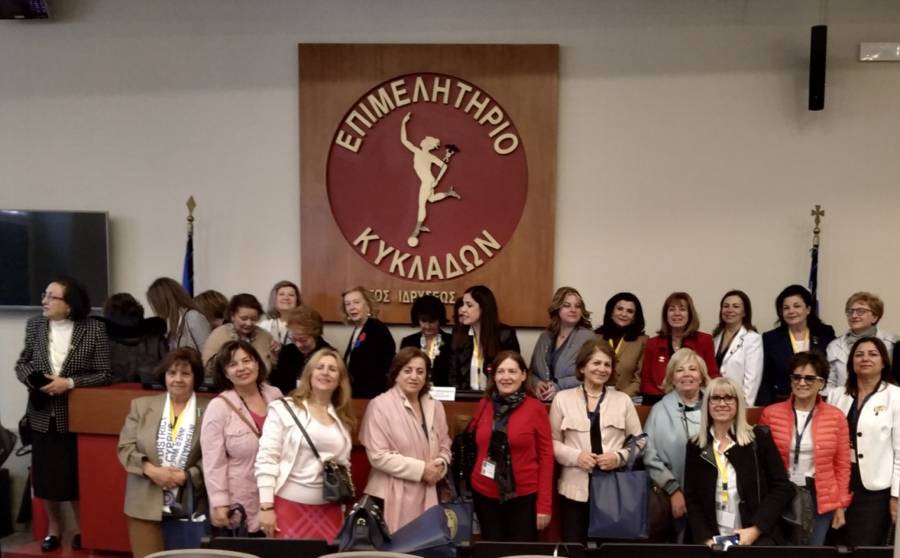
WORKSHOPS

Slide 16
Ancient Tragedy Cocktails at the “Electra by Sophocles” theatre’s foyer

Slide 17
CONFERENCE – 2ND DAY “Final Conclusions”

Slide 18
CONFERENCE – 2nd day

Slide 19
CONFERENCE – 2nd day

Slide 20
Closing Ceremony Organising Committee of WfE9

Slide 21
Closing Ceremony

Slide 22
Closing Ceremony

Slide 23
Gala Dinner “Greek night”

Slide 24
Gala Dinner

Slide 25
Guided Tours

Slide 26
Twinship Ceremony

Slide 27
Notes:
PRESENTATION IN 13th E.M.2019-MUNSTER
YIANNA GRAVIA KALYVA,D.N.R.2019-2020 247 D. GREECE

